Slide 1

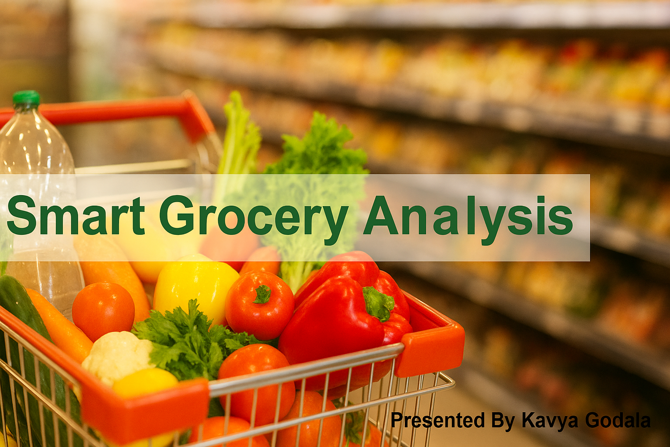
A 7-Step Journey to Improving Sales & Reducing Waste

Slide 2


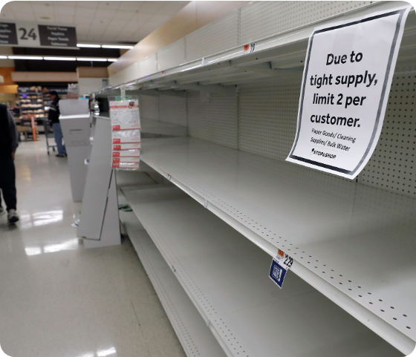
The Industry Challenge
Customer Frustration: When favorite items aren't on the shelf, shoppers leave unhappy.
Lost Money: Stores lose profit when they can't sell items customers want (Stockouts).
Wasted Food: Over-stocking leads to expired products that must be thrown away.
The Opportunity: Smart planning can boost profit by 30% and cut waste by 40%.

Slide 3

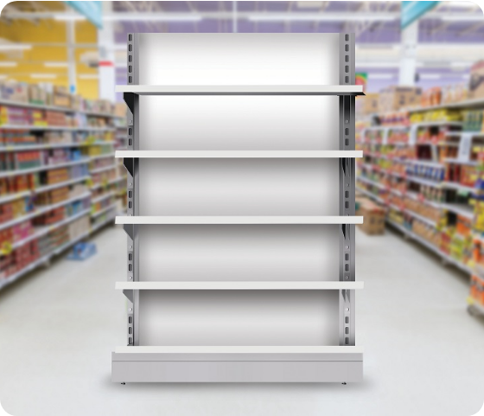
Step 1: Identifying the Problem
Stockouts: Essentials like Milk and Bread were frequently missing from shelves.
Wastage: Fresh vegetables and dairy products were expiring before being sold.
Fluctuations: Sales numbers swung wildly based on weather changes.
Manual Errors: Guesswork in ordering caused a 9% loss in potential customers.

Slide 4
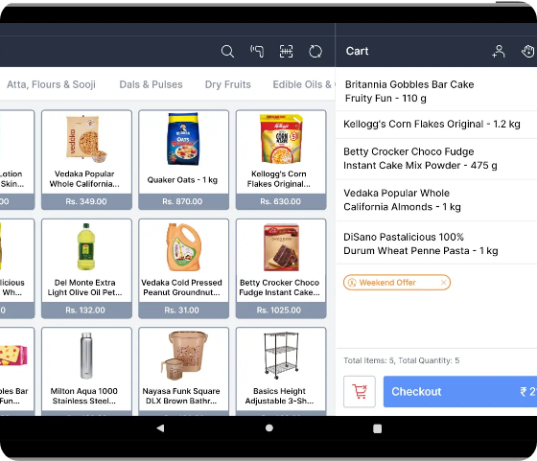
Step 2: Data Collection
Sales Records: Tracking exactly what item sold and at what time of day.
Inventory Logs: Monitoring current stock levels and expiry dates.
Supplier Data: Recording delivery schedules and any unexpected delays.
External Factors: Noting local weather conditions and upcoming festivals.

Slide 5
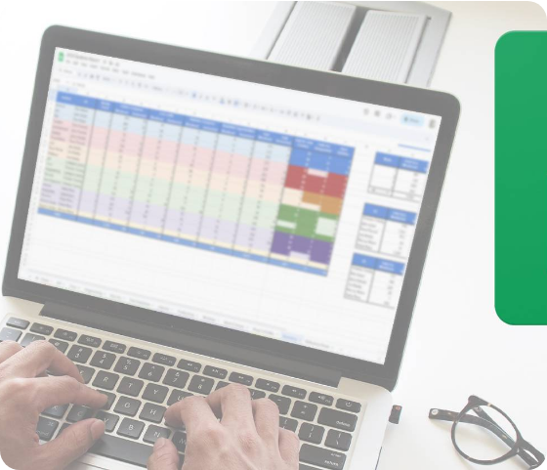
Step 3: Data Cleaning
Removed Duplicates: Deleted accidental double-entries to ensure accuracy.
Fixed Glitches: Corrected impossible values like negative sales numbers.
Standardized Names: Renamed items (e.g., "Tomato-1kg") to a single format.
Synced Time: Aligned transaction timestamps across all store branches.

Slide 6

Step 4: Data Exploration
Morning Rush: High demand for breakfast items between 7 AM and 10 AM.
Evening Prep: Peak sales for dinner ingredients occur from 5 PM to 9 PM.
Weekend Spikes: Sales volume jumps by 25-40% on Saturdays and Sundays.
Rainy Days: Sudden increase in sales for snacks and instant foods.

Slide 7
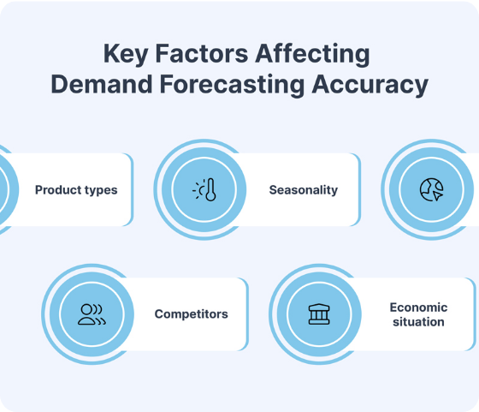
Step 5: Building a model
Demand Forecasting: Predicting specific daily sales for every single item.
Smart Reordering: Calculating the perfect stock amount to prevent overflow.
Holiday Adjustments: Automatically increasing stock before major festivals.
Waste Prevention: Ensuring perishables are sold before they expire.

Slide 8

Step 6: Evaluate the model
Fewer Stockouts: Missing items dropped drastically from 12% to just 4%.
Less Waste: Daily loss from spoiled food was cut by nearly 37%.
Happy Customers: Complaints regarding product availability fell by 45%.
Higher Revenue: Overall store sales increased by approximately 18%.

Slide 9

Step 7: Share insights & Implementation
Auto-Suggestions: Managers receive daily automated ordering recommendations.
Expiry Alerts: System warns staff when items are close to expiring.
Smart Discounts: Slow-moving items are automatically flagged for sales.
Weekly Reviews: Regular check-ins on demand trends for each store.

Slide 10




Final Business Impact
+₹40 Lakhs/Year
Additional revenue from better availability.
-₹12 Lakhs/Year
Saved by reducing food waste.
Happy Customers
Higher satisfaction scores & retention.

Slide 11


